Slide 1


Guatemala SQL Server user group
February 2020

Slide 2








Gracias a nuestros patrocinadores

Slide 3

Quienes somos?
Misión
Facilitar el "networking”, intercambio de conocimiento y experiencias a través eventos mensuales, anuales y virtuales.
Visión
Desarrollar una red profesional a nivel nacional, promoviendo la interacción con últimas tendencias en tecnologías de plataforma de datos Microsoft y otras (Open Source).

Slide 4
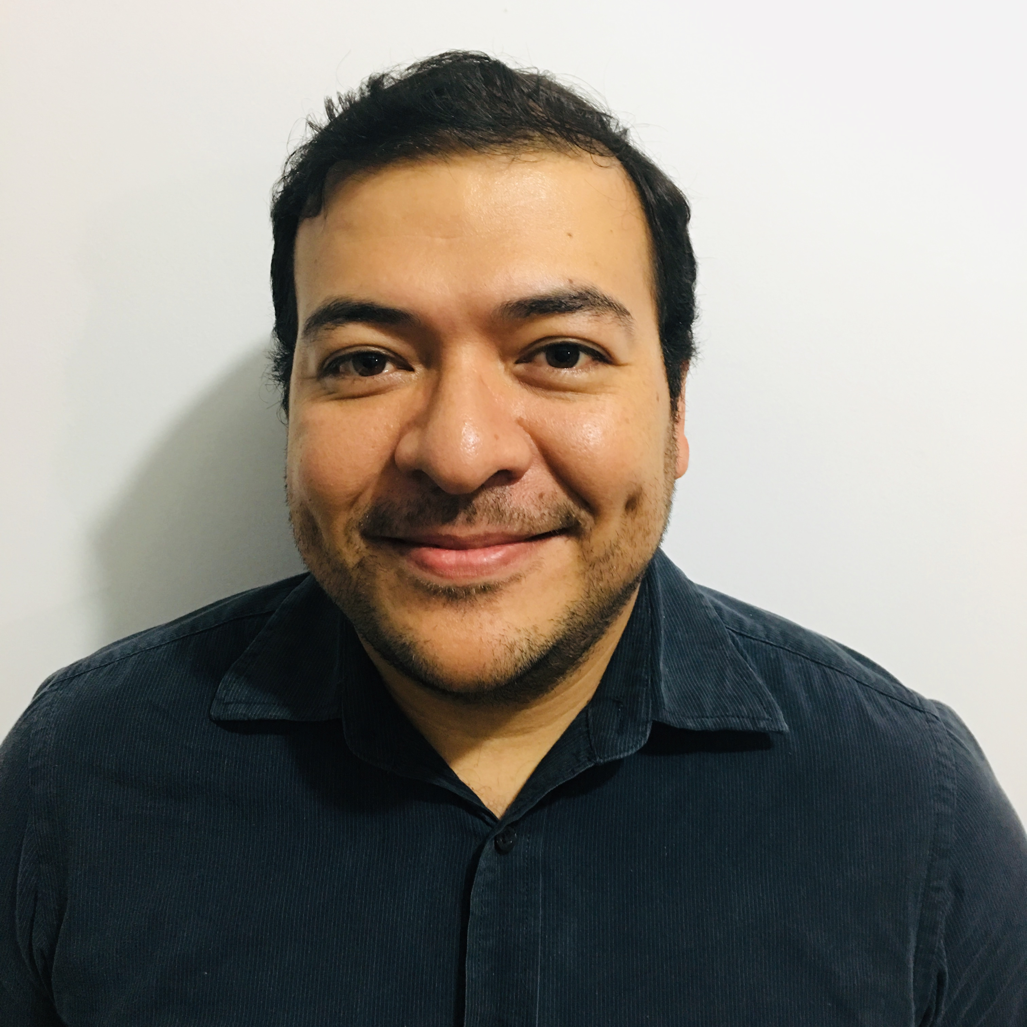
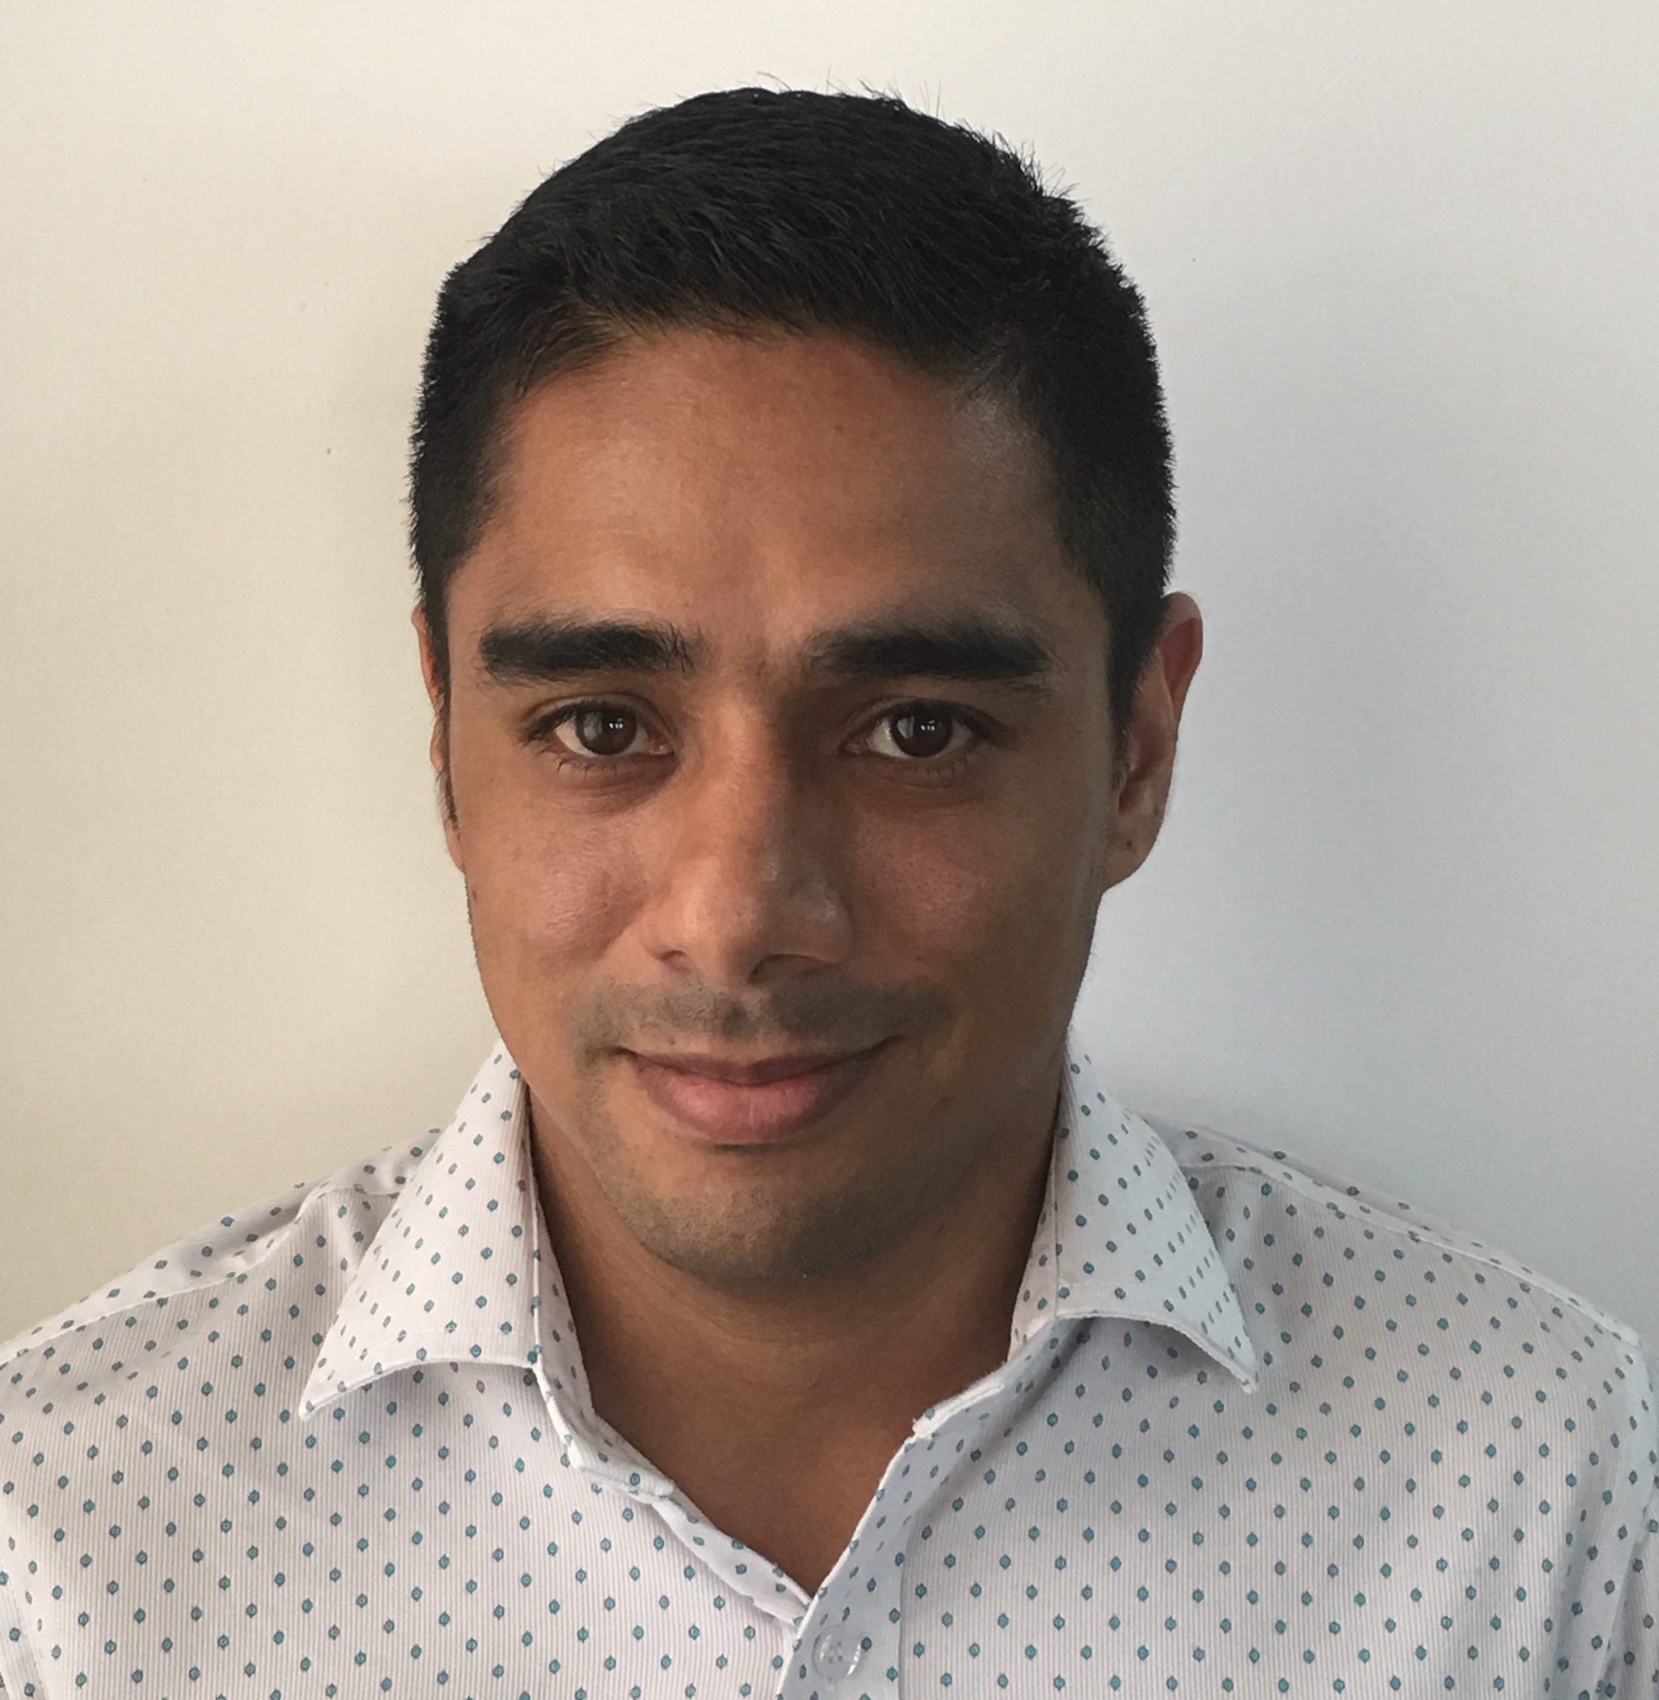
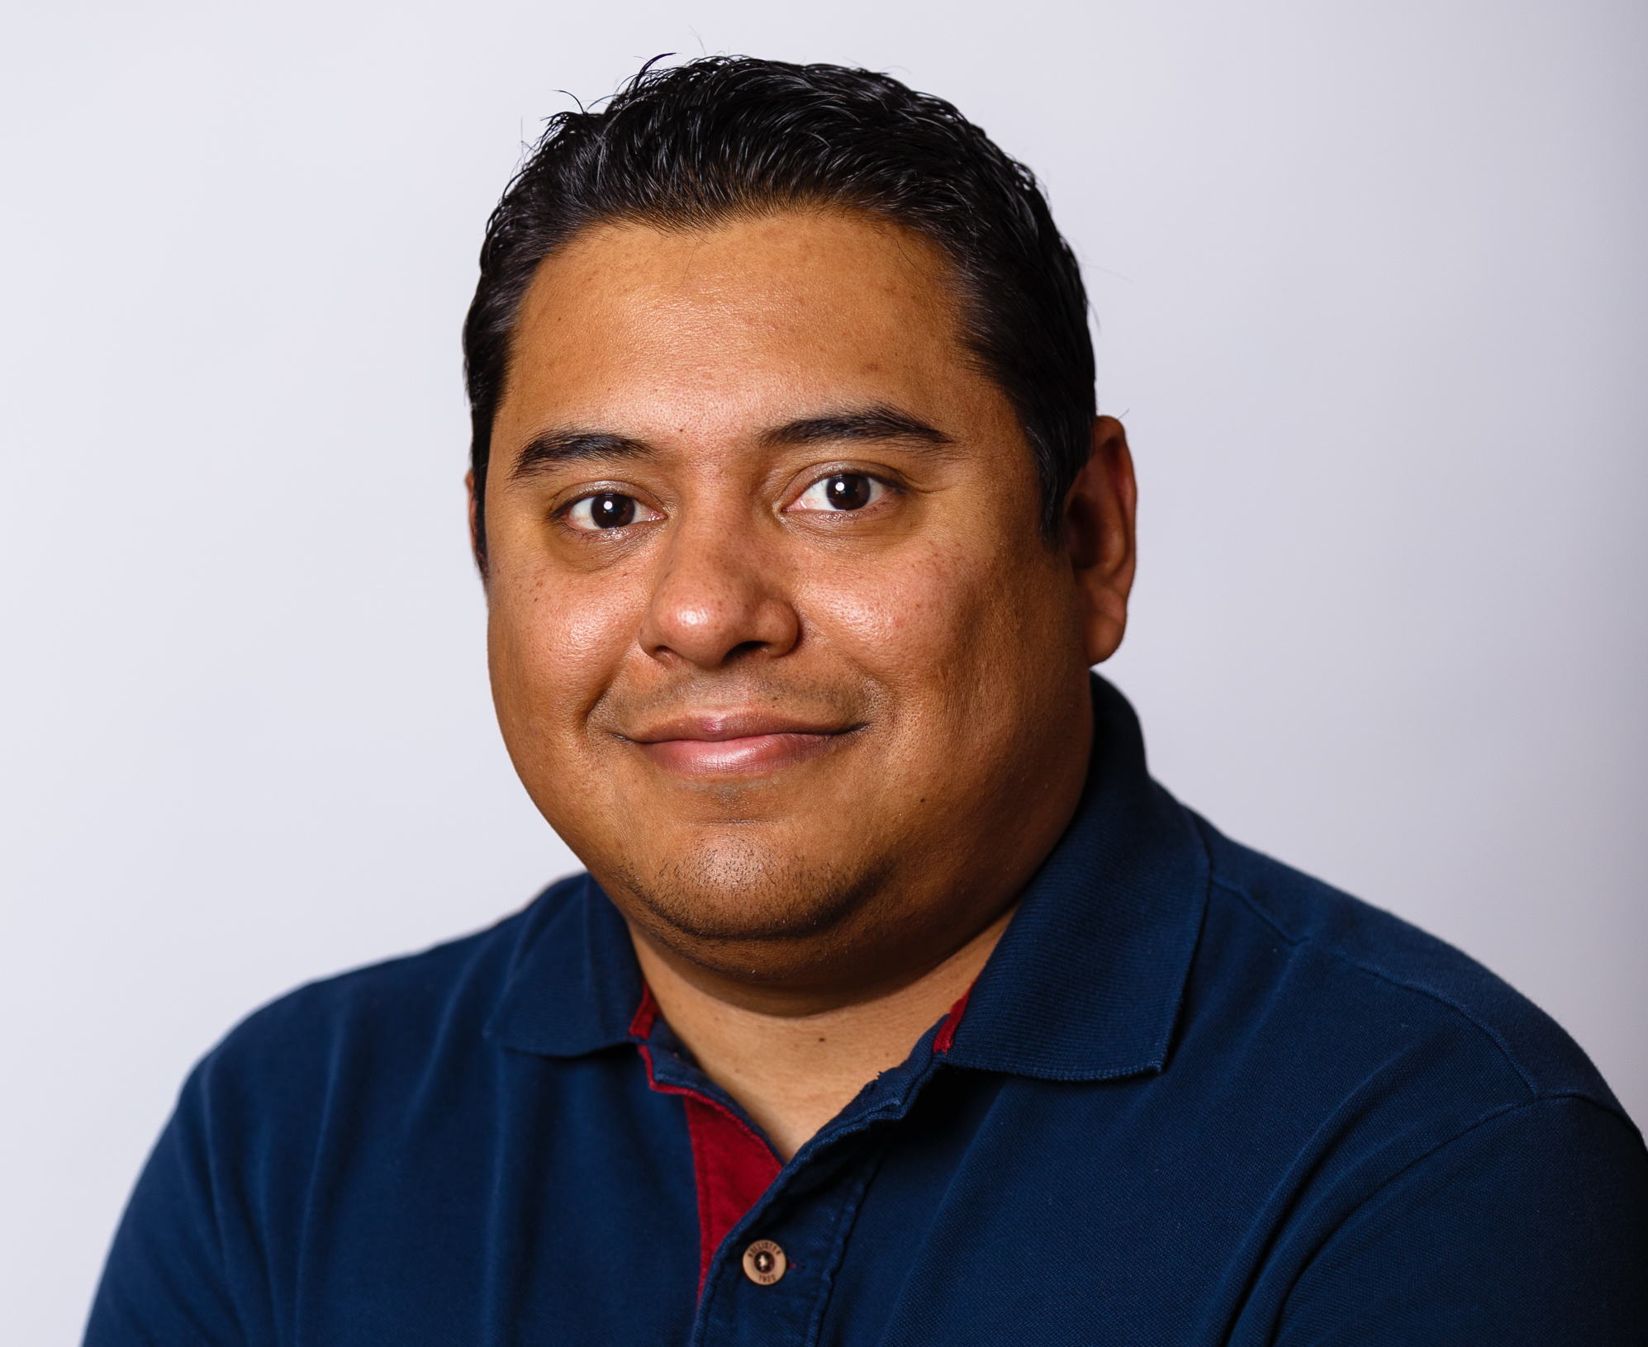
Lideres de la comunidad
Carlos Lopez
Eduardo Pivaral
Carlos Robles

Slide 5

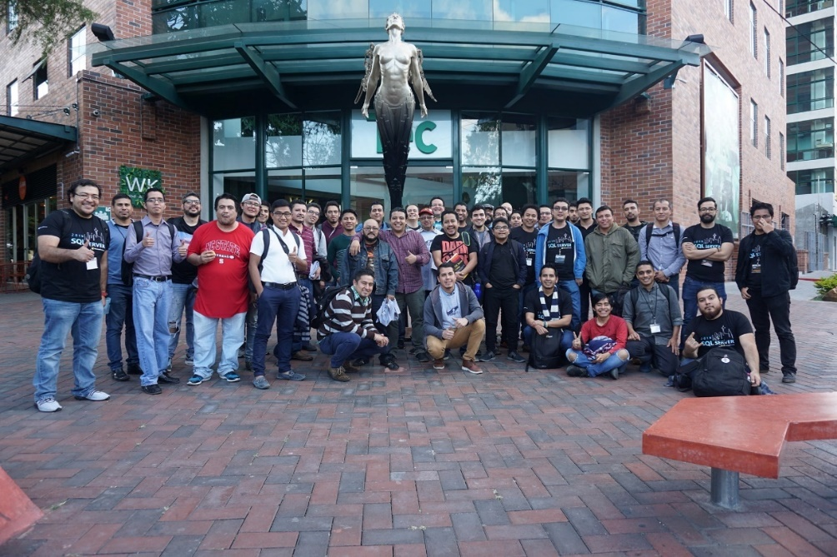
Gracias a todos!

Slide 6


Slide 7




Se parte de esta comunidad
GTSSUG.PASS.org
#SQLPassGT @gtssug

Slide 8

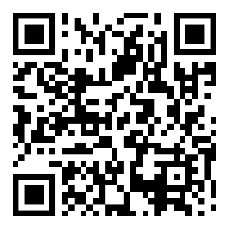
PASS Partner Webinar: Datavail March 05, 2020 | 11:00 AM
Accelerating SQL Server Migration to the AWS Cloud
In this webinar, Jeff Duncan a DBA Manager, SQL Server at Datavail will discuss accelerating SQL Server Migration to the AWS Cloud and explain the advantages and disadvantages of using different methods. He will also showcase the surprises and pitfalls to avoid as we venture into the process.
Learn more on what trends you can expect to see, what the future holds for cloud, and see how the DBA role and their responsibilities are undergoing changes to fit into the new profile necessary in managing the cloud framework
Register Now
pass.org/marathon/2020/datavail/About.aspx

Slide 9

Upcoming Virtual Group Webinars
Virtual Group | Meeting Date | Time | Topic | Website
DBA Fundamentals | Mar 10, 2020 | 02:30 – 03:30 (UTC) | Habits of Highly Successful DBA Teams - Kevin Kline | fundamentals.pass.org
High Availability and Disaster Recovery | Mar 10, 2020 | 17:00 – 18:00 (UTC) | High Availability Options for SQL Server on Linux - Connor Cox | hadrvc.pass.org
Global Italian | Mar 11, 2020 | 17:00 – 19:00 (UTC) | SQL Server Query Store e Automatic Tuning - Sergio Govoni | globalitalian.pass.org
High Availability and Disaster Recovery | Mar 11, 2020 | 17:00 – 18:00 (UTC) | Automating the creation of missing logins on availability group replicas (Take 2) - Brandon Leach | hadrvc.pass.org

Slide 10
Upcoming Virtual Group Webinars
Virtual Group | Meeting Date | Time | Topic | Website
Data Architecture | Mar 11, 2020 | 18:00 – 19:00 (UTC) | Loading Your Data Vault with Azure Data Factory Mapping Data Flows - Rayis Imayev | dataarch.pass.org
Cloud | Mar 12, 2020 | 17:00 – 18:00 (UTC) | Throw a Brick at Your Data: Intro to Azure Databricks - Hope Foley | cloud.pass.org
Cloud | Mar 17, 2020 | 17:00 – 18:00 (UTC) | Azure Data Platform Security Overview - Azure Data Lake , Azure Data Factory & SQL Azure DB - Sriharsh Adari | cloud.pass.org
Women in Technology | Mar 25, 2020 | 16:00 – 17:00 (UTC) | The Evolution of Database Development and Administration - Kendra Little | wit.pass.org
Database Administration | Mar 25, 2020 | 18:00 – 19:00 (UTC) | Azure Data Security - Tim Radney | dba.pass.org

Slide 11

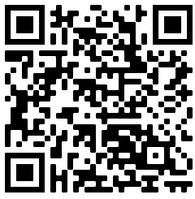
Contribuye con nosotros!
Deseas participar como speaker en nuestro siguiente meetup?
Llena esta forma en linea con una descripcion de tu session, nosotros te contactaremos.
https://gtssug.pass.org/en-us/sessionsubmission.aspx

Slide 12




















PASS Virtual Groups

Slide 13


Connect with PASS
PASS.org
#sqlpass @sqlpass
@passcommunity

